Slide 1
Network Programming and Security
CS362IA
Title: Decentralized DNS system Using Blockchain and Machine Learning
USN | NAME
1RV22CS119 | MOHITH S
Guide:
Dr. Pavithra H
Associate Professor
Computer Science and Engineering

Slide 2
INTRODUCTION
A decentralized DNS (Domain Name System) using blockchain and machine learning is a modern approach to managing internet domain names securely and intelligently, without relying on a single central authority. Blockchain technology distributes and stores domain records securely across a network of computers, ensuring transparency and resistance to tampering. In addition, our system integrates a machine learning model to automatically classify and filter out malicious domains, providing an extra layer of protection against cyber threats like phishing and malware. This combination of decentralization and intelligent threat detection offers a more secure and reliable DNS infrastructure for the modern internet.

Slide 3
PROBLEM STATEMENT & OBJECTIVES
Problem Statement:
Traditional DNS systems are centralized and managed by a few organizations, making them vulnerable to single points of failure, cyber-attacks, censorship, and domain hijacking. This centralization can lead to security risks, lack of transparency, and limited user control over domain ownership. There is a need for a more secure, transparent, and censorship-resistant solution for managing domain names on the internet.
Objectives:
Provide a secure and tamper-proof system for domain name management using blockchain technology.
Eliminate single points of failure and reduce the risk of unauthorized changes in DNS records.
Enhance user privacy and control by enabling decentralized and transparent ownership of domain names.

Slide 4
LITERATURE SURVEY
Paper Title, Author & Publication | Summary | Key Findings | Research Gap
Title: Blockchain Based Decentralized Technology For Internet Naming Systems Authors:Apurva Tamhankar, Sunita Dhavale, Arun Mishra, Balaji Rajendran, Gopinath Palaniappan Journal:IEEE Region 10 Humanitarian Technology Conference (R10-HTC), 2023 | Reviews centralized DNS flaws and blockchain-based alternatives. Uses ML and DL to detect malicious domains in Ethereum datasets. | Achieved 99% accuracy with Decision Tree and 95% with CNN. Extracted 17 features for phishing domain detection. | Lacks a unified cross-blockchain protocol, making it difficult to ensure consistent and tamper-proof domain management across platforms. Existing detection mechanisms are not fast or accurate enough to protect user privacy and prevent unauthorized DNS changes in real time.

Slide 5
LITERATURE SURVEY
Paper Title, Author & Publication | Summary | Key Findings | Research Gap
Title: Blockchain-Enabled DNS: Enhancing Security and Mitigating Attacks in Domain Name Systems Authors:Kaushal Shah, Mukti Padhya, Sachin Sharma Journal:IEEE 6th International Conference on Signal Processing and Information Security (ICSPIS), 2023 | Proposes a 3-tier blockchain DNS to counter DDoS and DNS vulnerabilities. Analyzes impact, feasibility, and cost of blockchain DNS. | Eliminates single point of failure using blockchain decentralization. Successfully mitigates DDoS through layered architecture. | Focuses heavily on DDoS; needs a more complete framework to eliminate single points of failure and secure all DNS layers. Does not fully address user privacy and ownership control through decentralized identity or smart contract-based access.

Slide 6
LITERATURE SURVEY
Paper Title, Author & Publication | Summary | Key Findings | Research Gap
Title: D-DNS: A Decentralized Domain Name System on the Blockchain: Implementation and Assessment Authors:Usha Divakarla, K. Chandrasekaran Journal:IEEE International Conference on Blockchain and Distributed Systems Security (ICBDS), 2024 | Proposes D-DNS using PoS and domain indexing for performance. Compares D-DNS security and latency with legacy DNS. | Reduced attack success rate to 1% compared to legacy DNS. Query latency matches commercial DNS levels. | While it improves security, it lacks mechanisms to transparently assign and revoke domain ownership, limiting user control. More work is needed to make the system scalable and tamper-resistant in real-world, high-load environments.

Slide 7
LITERATURE SURVEY
Paper Title, Author & Publication | Summary | Key Findings | Research Gap
Title: Securing Domain Name Systems with Blockchain Authors:Joshua Theoder, Binusha Shabu Metharath, Sahel Alouneh Journal:IEEE 4th International Conference on Intelligent Data Science Technologies and Applications (IDSTA), 2023 | Develops an Ethereum-based DNS proof-of-concept using smart contracts. Integrates CLI, DNS server, and Docker for test setup | Achieved functional record setting and resolution on blockchain. Showed feasibility of decentralization via Ethereum smart contracts. | The proof-of-concept lacks scalability and advanced controls needed to prevent unauthorized changes in a live environment. User privacy features are basic; no integration of decentralized identity management or ownership transfer mechanisms.

Slide 8
LITERATURE SURVEY
Paper Title, Author & Publication | Summary | Key Findings | Research Gap
Title: SSHTDNS: A Blockchain-Based Secure, Scalable, and High-Throughput Domain Name System Authors:Dr. Baldev Singh, Ms. Kavita Journal:IEEE 3rd International Conference on Advance Computing and Innovative Technologies in Engineering (ICACITE), 2023 | Proposes SSHTDNS with consortium chain, sharding, and linkable signatures. Designed for fair voting, high throughput, and global scalability. | Ensures anonymity in TLD voting using ring signatures. Uses sharding to boost DNS performance and throughput. | No validation or testing to prove that the system can fully prevent tampering or unauthorized record changes in production. Does not clearly outline how users can own, control, or transfer domains transparently in a decentralized way.

Slide 9
METHODOLOGY
1. Decentralized DNS Using Blockchain
Traditional DNS is centralized, making it vulnerable to single-point failures and DNS spoofing attacks.
We use Blockchain to store domain name to IP mappings in a distributed ledger.
2. Domain Validation using Machine Learning
A custom-trained ML model is integrated into the system to analyze domain names.
The domain is classified as either safe or malicious.
3. User Input:
User enters a domain name through the application interface.
4. The ML model analyzes the domain name:
If malicious → access is denied.
If safe → proceed to next step.
5. Blockchain Lookup:
The system queries the blockchain ledger to retrieve the IP address mapped to the domain.
6. Response to User:
If the domain is safe and mapping exists, the corresponding IP address and Port number is returned.
Otherwise, the user is informed that the domain is malicious or not found.

Slide 10
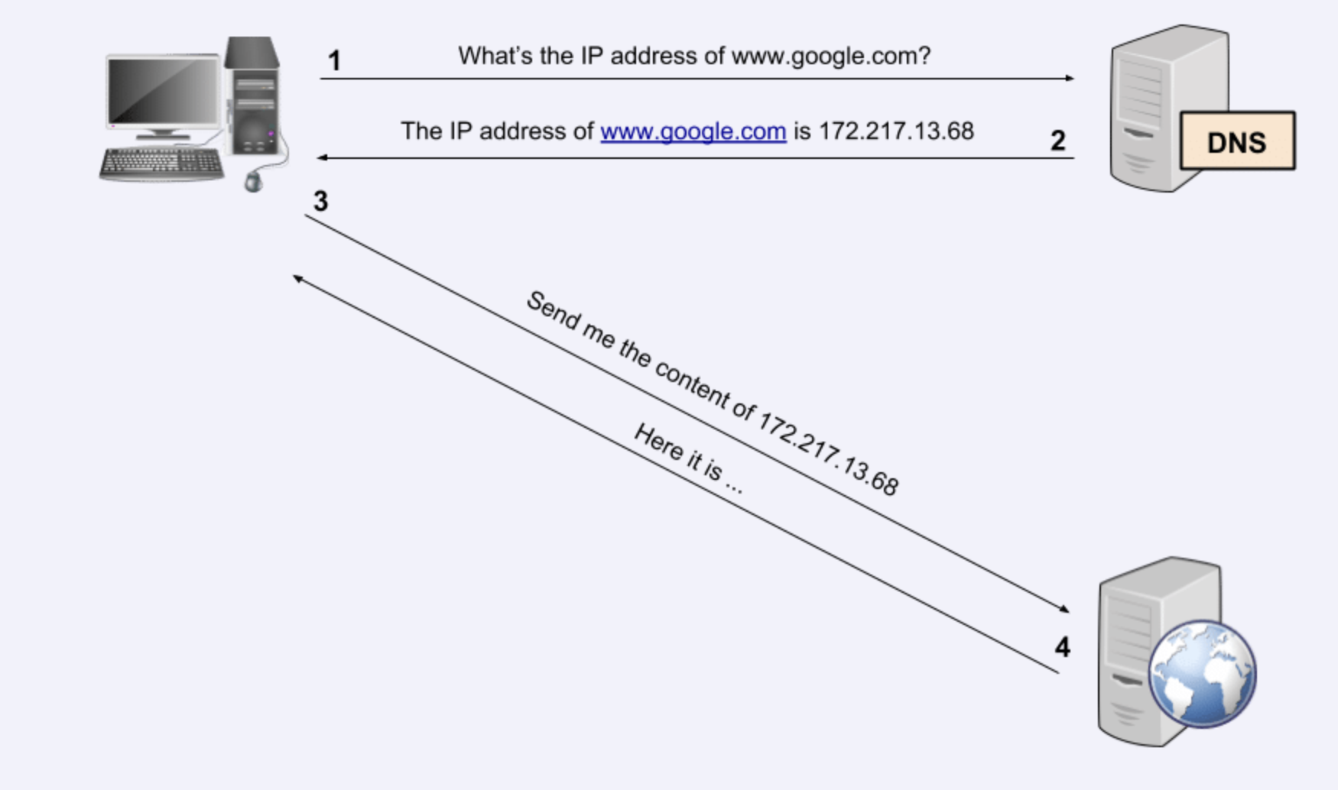
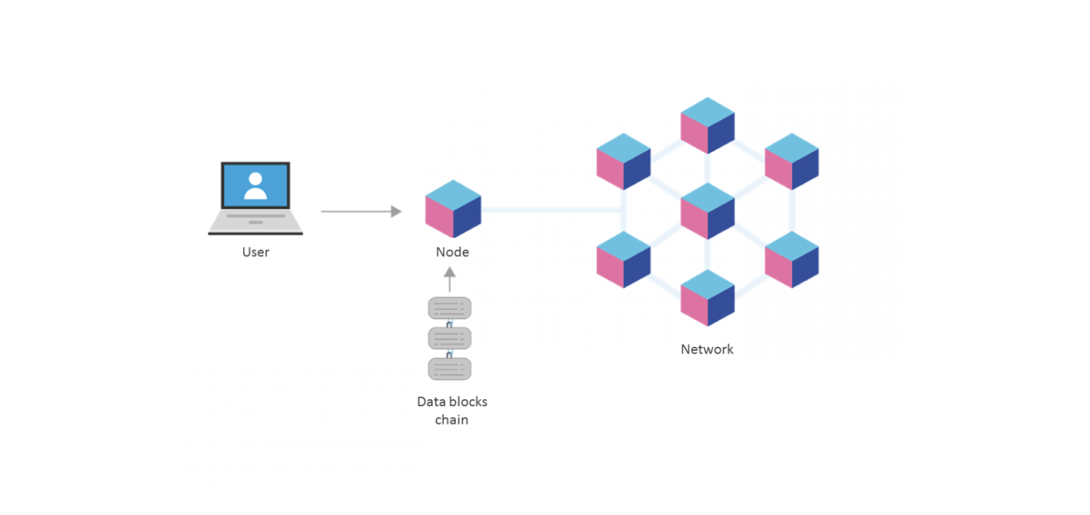
METHODOLOGY

Slide 11
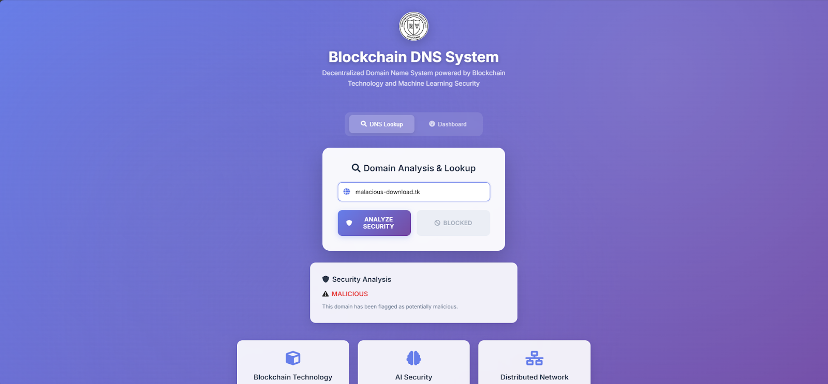
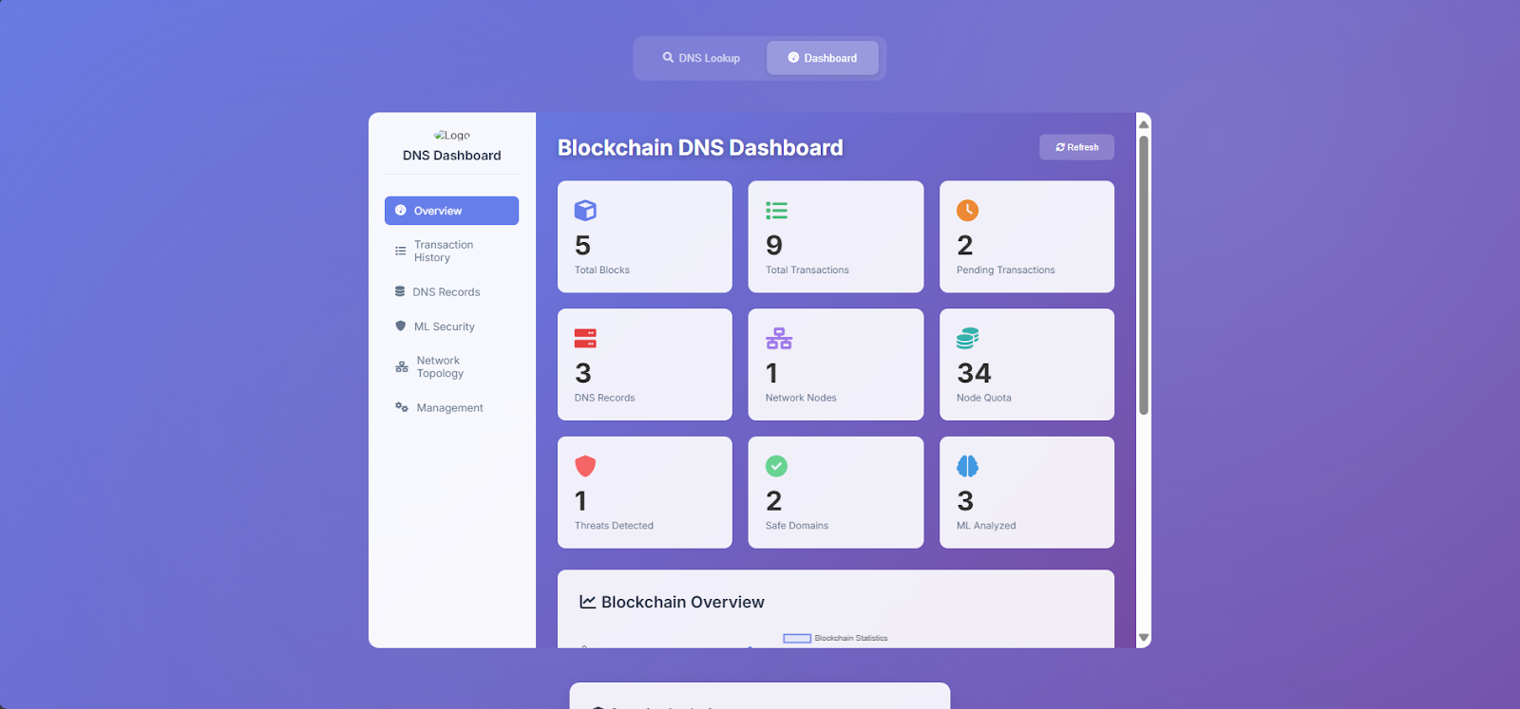
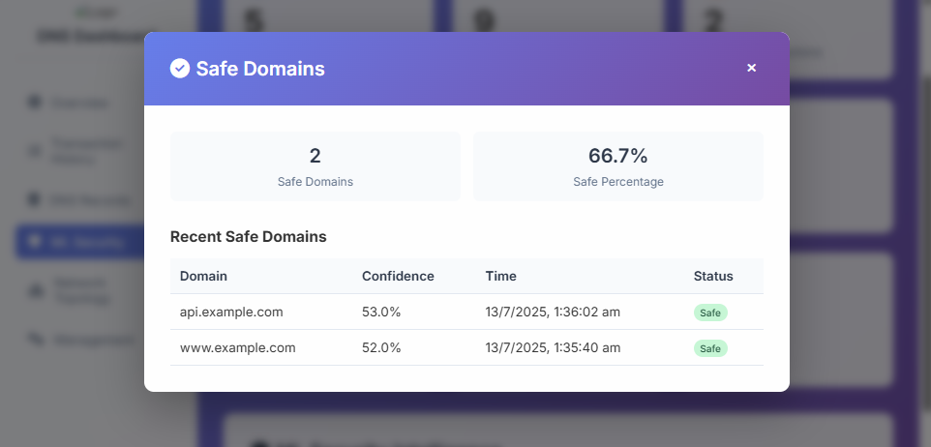
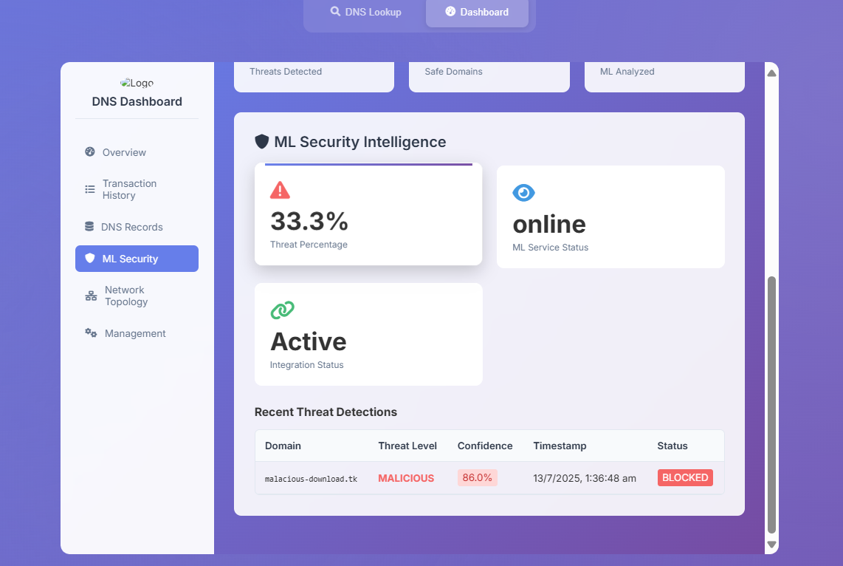

Slide 12
CONCLUSION
In this project, we have successfully designed and implemented a decentralized DNS system that integrates blockchain technology with machine learning to enhance both security and reliability. By using blockchain, we eliminated the limitations of traditional, centralized DNS systems, such as single points of failure and susceptibility to spoofing or tampering. Additionally, we incorporated a machine learning model to intelligently classify domain names as safe or malicious based on specific features. This ensures that only safe domains are resolved, thereby adding an extra layer of security against phishing, malware, and other cyber threats. Overall, our system provides a more secure and trustable DNS resolution mechanism and offers a scalable foundation for future advancements in secure internet infrastructure.

Slide 13
REFERENCES
A. Tamhankar, S. Dhavale, A. Mishra, B. Rajendran, and G. Palaniappan, “Blockchain Based Decentralized Technology for Internet Naming Systems,” 2023 IEEE Region 10 Humanitarian Technology Conference (R10-HTC), pp. 1–7, 2023, doi: 10.1109/R10-HTC57504.2023.10461759.
K. Shah, M. Padhya, and S. Sharma, “Blockchain-Enabled DNS: Enhancing Security and Mitigating Attacks in Domain Name Systems,” 2023 6th International Conference on Signal Processing and Information Security (ICSPIS), pp. 21–28, 2023, doi: 10.1109/ICSPIS60075.2023.10343534.
U. Divakarla and K. Chandrasekaran, “D-DNS: A Decentralized Domain Name System on the Blockchain: Implementation and Assessment,” 2024 IEEE International Conference on Blockchain and Distributed Systems Security (ICBDS), Pune, India, pp. 1–8, 2024, doi:10.1109/ICBDS61829.2024.10837028.
J. Theoder, B. S. Metharath, and S. Alouneh, “Securing Domain Name Systems with Blockchain,” 2023 Fourth International Conference on Intelligent Data Science Technologies and Applications (IDSTA), pp. 48–54, 2023, doi: 10.1109/IDSTA58916.2023.10317833.
B. Singh and K. Kavita, “SSHTDNS: A Blockchain-Based Secure, Scalable, and High-Throughput Domain Name System,” 2023 3rd International Conference on Advance Computing and Innovative Technologies in Engineering (ICACITE), pp. 2192–2198, 2023, doi:10.1109/ICACITE57410.2023.10182552.

Slide 14
THANK YOU

